Slide 1

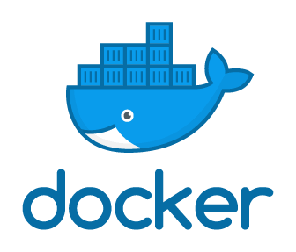
(BCSE 0510) Container Orchestration and Infrastructure Automation
Utilizing Microservices
Lecture: 5
Lecture By: Ms. Ambika Gupta

Slide 2
AGENDA
Microservices
Docker Editions
Build Kit Features

Slide 3
MICROSERVICES
Docker is an open platform for developing, shipping, and running applications. You can develop applications very fast and deploy them fast.
Using Docker, it is easy to create required services separately and manage them as microservices without affecting other services.

Slide 4
MICROSERVICES
Today developers are using Docker to build modules called microservices, which decentralize packages and divide tasks into separate, stand-alone apps that collaborate with each other.

Slide 5
MICROSERVICES

Slide 6
MICROSERVICES
Containers are a good way to develop and deploy microservices, and the tools and platforms for running containers are a good way to manage microservice-based applications.

Slide 7
MICROSERVICES
How many Microservices are in a container?
One microservice: one container.

Slide 8
DOCKER EDITIONS CONTD..
Docker is available in two editions:
Community Edition (CE)
Enterprise Edition (EE)

Slide 9
Docker Community Edition (CE)
It is ideal for individual developers and small teams looking to get started with Docker and experiment with container-based apps.

Slide 10
Docker Enterprise Edition (EE)
It is designed for enterprise development and IT teams who build, ship, and run business-critical applications in production at scale.

Slide 11
Docker Enterprise Edition (EE)
Docker Enterprise Edition comes in three versions: basic, standard and advanced.
The Basic edition comes with the Docker platform, support and certification, while the Standard and Advanced versions add additional features such as container management (Docker Datacenter) and Docker Security Scanning.

Slide 12
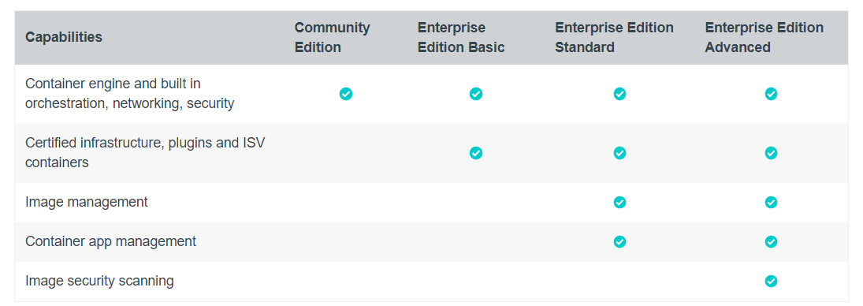
DOCKER EDITIONS CONTD..

Slide 13
DOCKER BUILD KIT FEATURES
Automatic garbage collection
Extendable frontend format
Concurrent dependency resolution
Efficient instruction caching
Build cache import/export

Slide 14
DOCKER BUILD KIT FEATURES
Nested build job invocations
Distributable workers
Multiple output formats
Pluggable architecture
Execution without root privileges

Slide 15


